Slide 1

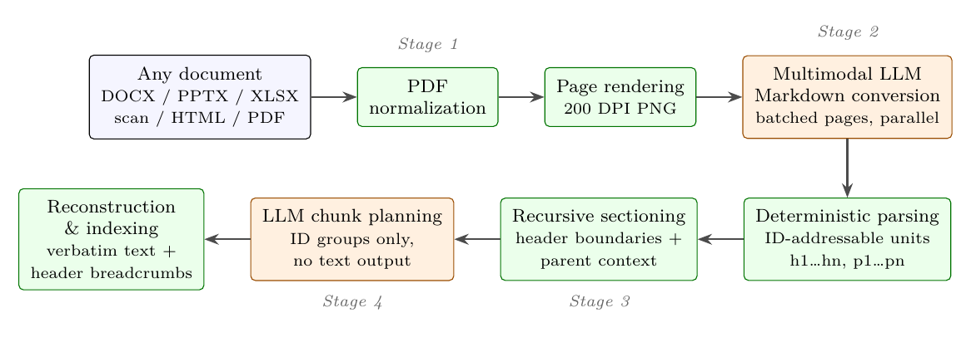
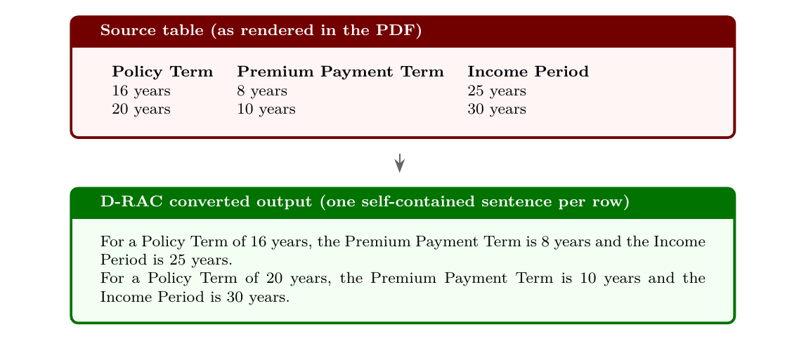

Document Retrieval-Aware Chunking (D-RAC): Universal Retrieval-Aware Ingestion of
Enterprise Documents via PDF Normalization and Multimodal Markdown Conversion
Uday Allu · Abhivanth Sivaprakash · Pratik Singh · Aman Manocha
AI Research Team, Yellow.ai
Problem
Method
Key Results
Headline Numbers
PDF preserves appearance—not
retrieval-ready structure.
1
Normalize to PDF and render page images.
Comparable retrieval, cheaper planning. On 762
queries, D-RAC matches or exceeds agentic chunking
on all seven aggregate metrics.
−95.7%
−77.8%
Cost ·
GPT-4.1
Enterprise documents hide facts in visual
layouts. Rule-based extraction breaks
reading order, headings, and table context.
2
Convert once to retrieval-aware Markdown.
Chunking-stage
output tokens
−85.6%
Cost ·
Gemini
3
Parse and section into ID-addressable elements.
SYSTEM
R@6
MRR
NDCG@6
270,454 → 11,714 output
tokens
−75%
Planning time
4
Plan ordered ID lists; reconstruct text locally.
Fixed-size
0.717
0.602
0.764
Agentic chunking repairs structure by
regenerating text, adding output-token
cost and opportunities to alter content.
Agentic
0.795
0.682
0.793
D-RAC
0.798
0.690
0.801
Takeaway
Table 6: Titan Text Embeddings V2 with cosine top-K
retrieval; identical relevance judging across systems.
Convert once. Plan over IDs.
Reconstruct locally.
Motivation
Relative to fixed-size extraction, Recall@6 rises 11.3%
and MRR rises 14.6%. The gain over agentic chunking
is much smaller.
Re-chunk cheaply without rewriting
converted text.
REGENERATE
vs.
RE-PLAN
Fidelity starts after conversion. Charts
are suppressed. Reported cost savings
exclude the one-time multimodal
conversion.
Rewrite
document text
for every new
chunk plan.
Reuse converted
text; change only
identifier groups.
Figure 1. Orange stages use an LLM; green stages are
deterministic.
The planner emits IDs, not prose. Chunking
preserves the converted text.
Cost of planning—not conversion
PRICING SCENARIO
AGENTIC
D-RAC
Boolean queries favor agentic
chunking. No component-isolation
ablation is reported.
Understand once, reuse often. D-RAC
puts multimodal understanding at ingestion
and keeps repeatable chunking at the
identifier level.
GPT-4.1
$2.815
$0.624
Gemini 2.5 Pro
$3.112
$0.448
Table 10: chunking-stage cost for the full 236-
document corpus, using the paper’s reported rates.
One-time multimodal conversion is excluded.
A table value needs its row and column
context to be retrievable. Keep distinct
rows separate rather than merging options
into an ambiguous “or” sentence.
The complete run creates 1,748 chunks from 795
pages in 71.7 minutes, with zero reported conversion
or chunking errors.
Scan to Read
Figure 2. Each table row becomes a statement with full
column context.
Paper

